Slide 1


Optimising Faith-Driven Operations: Process Redesign and Digital Transformation Proposal for FaithWorks
Presented By:
Saraf Rahman Khan (110438694)

Slide 2


Mission
Did you know that Australians waste around 7.6 million tonnes of food every year? That’s enough to fill the Melbourne Cricket Ground nine times over.
FaithWorks
“ Rescuing food and distributing to those in need”
Fact check:
HTTPS://WWW.DCCEEW.GOV.AU/ENVIRONMENT/PROTECTION/WASTE/FOOD-WASTE

Slide 3
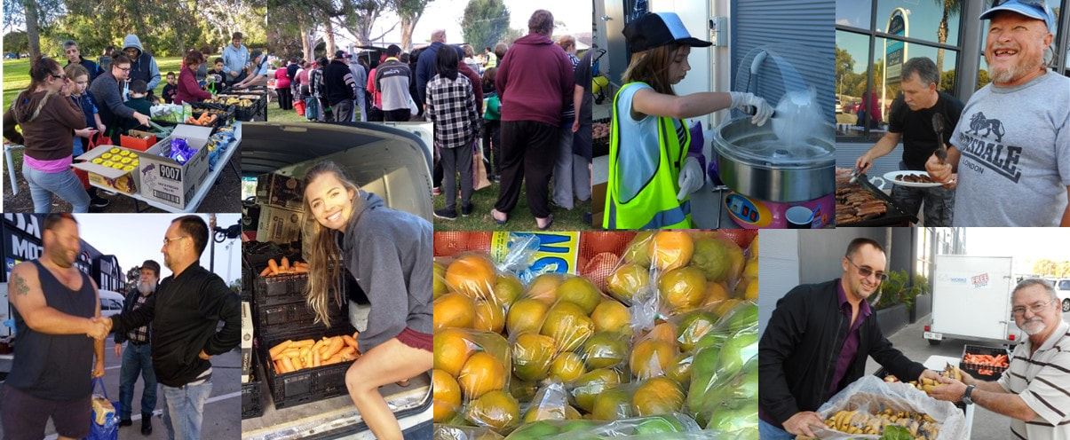
Company & Industry Overview: FaithWorks
The retail sector is rapidly evolving with technology, adopting digital inventory, automated checkouts, and data-driven processes to enhance efficiency and customer experience.
FaithWorks is a faith-driven organization based in Adelaide, making a real difference for 100 to 200 families every day. Powered by dedicated volunteers, they transform donated food—including items that might otherwise go to waste—into carefully sorted and distributed essentials. At their shop, families can access groceries and meals at very low prices, or sometimes for free, ensuring that everyone receives support while helping to sustain the organization’s mission
Fact check:
FaithWorks Website

Slide 4
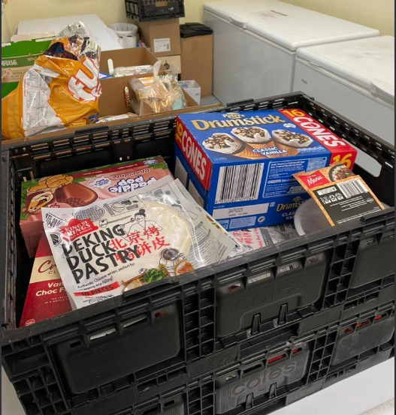

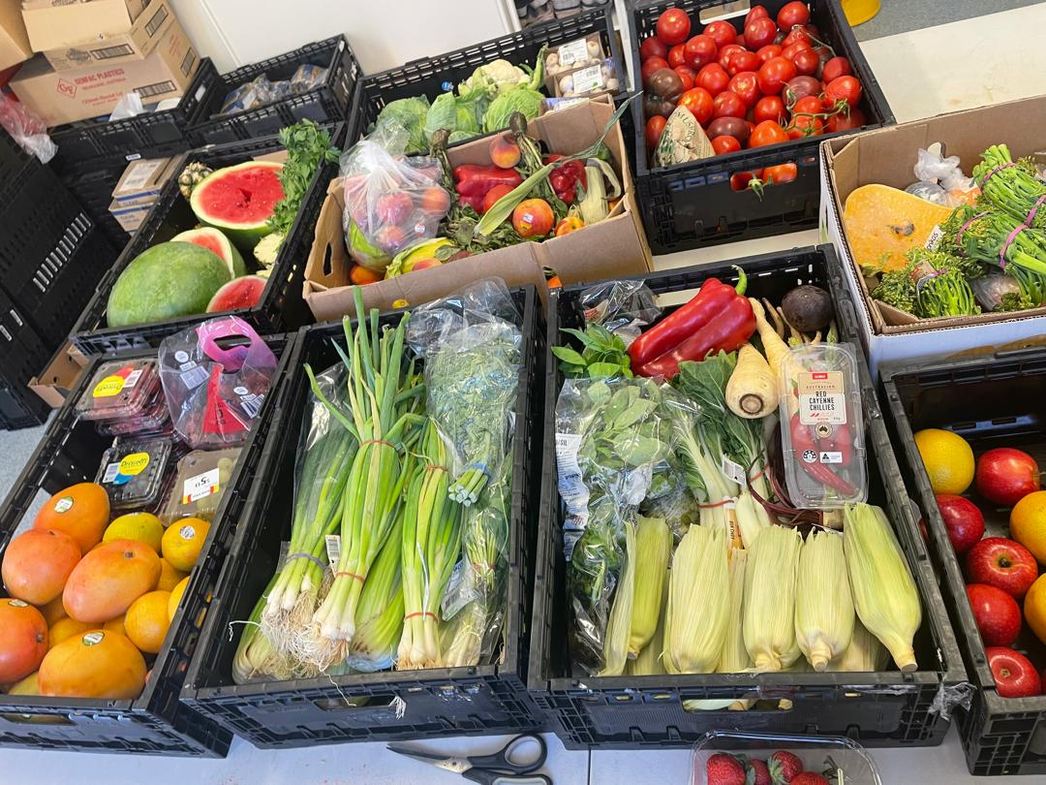
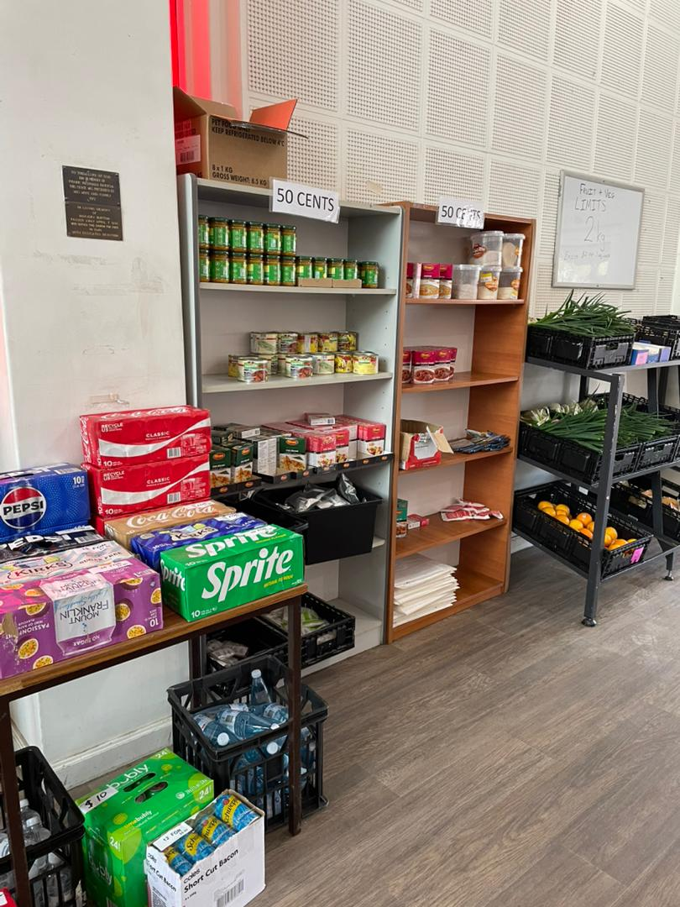
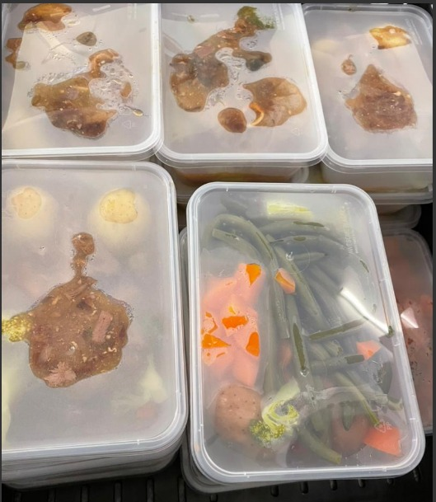

Primary Processes
Primary Processes (Core Activities)
Storage management
Customer service & checkout
Receiving and sorting donations
Repackaging and shelf stocking
Kitchen Operations: lunchboxes sold for $2 with day’s ingredients
Inventory control

Slide 5


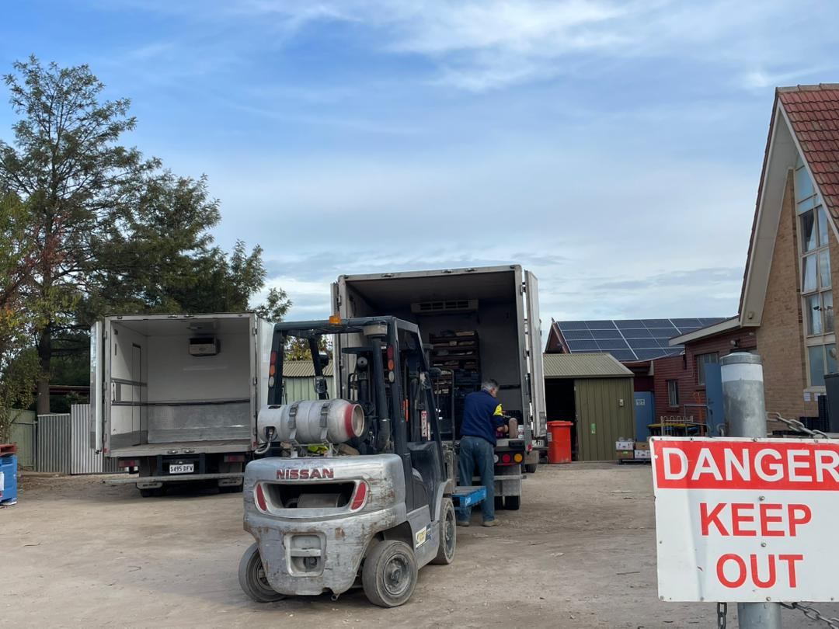
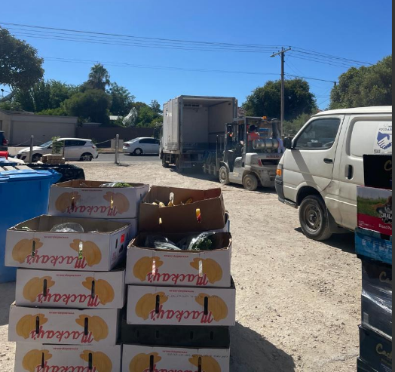
Secondary Processes
Primary Processes (Core Activities)
Secondary Processes (Supporting Activities)
Management Processes
Transportation- moving and unloading the donated goods
Volunteer training and onboarding
Cleaning and Maintenance
Donor Reporting
Coordinating Weekly Volunteer Work
Strategic Planning and Decision-Making
Financial Oversight and Budgeting

Slide 6







As-Is Process: Categorical Sorting, Quality Control & Strategic Storage (Process 1)
Step 1
Step 2
Step 3
Step 4
Step 5
Challenges
Initial Donation
Initial Sorting
Storage & Expiry Check
Meal Prep & Store Transfer
Inventory Monitoring
Manual and Labour-Intensive
Inconsistent Standards
Repetitive Handovers
Limited Tracking and Visibility
Prone to Errors and Waste
Difficult to Scale
Transportation team collects and unloads donated goods.
Goods sorted into household, non-perishable, kitchen, and perishable items.
Sent to appropriate storage or meal prep.
Perishables checked for quality; good items repackaged, bad items discarded.
Other goods checked for expiry; expired items set aside, non-expired allocated to proper storage.
Kitchen preps lunch boxes for sale.
All ready items sent to store for distribution.
Staff regularly inspect inventory and adjust as needed.

Slide 7

As-Is: Customer Service & Checkout (Process 2)
Customer Entry & Membership Check:
Manual verification of membership at checkout; new members issued cards, replacements cost $5.
Item Allocation & Pricing:
Staff allocate three free items to members; vegetables weighed manually—fees for over 2kg; other items priced as needed.
Payment & Receipt:
Payment taken in cash or card; receipts often handwritten.
Yard Access:
Customers access additional free goods in the yard.
Challenges:
Manual steps, slow checkout
Prone to errors and inconsistencies
Difficult to track transactions and inventory
Stressful for staff and volunteers

Slide 8

To be: Categorical Sorting, Quality Control & Strategic Storage
Software Recommendation:
We recommend using Zoho Inventory Management System (Zoho IMS)—a cost-effective, barcode-enabled platform offering real-time tracking, easy reporting, and seamless integration for non-profits like FaithWorks.
Digital Pickup Confirmation
Drivers collect goods and send instant digital confirmation.
Barcode Generation & Attachment
Key details entered; barcode printed and attached to each batch.
Barcode Scanning & Sorting
Sorting team scans items into IMS; issues flagged for follow-up.
Automated Categorization & Allocation
IMS suggests where items go; sorting team confirms allocation.
Operations & Stock Coordination
Storage and operations use system data to manage transfers.
Kitchen Logging & Stock Automation
Meal prep logs usage; weekly automated updates optimize stock.
Fact check:
Zoho IMS

Slide 9
To be: Customer Service & Checkout
Digital Membership & Item Scanning:
Membership and items scanned into a cloud POS; automatic eligibility and pricing.
Automated Benefits & Pricing:
System applies free item rules and vegetable surcharges instantly.
Digital Payment & Receipts:
Fast, secure payments; receipts printed or sent via SMS.
Streamlined Customer Flow:
Faster, more consistent service; improved access to yard items.
Improvements:
Automation speeds up checkout
Reduces errors and manual work
Better tracking and transparency
Easier for volunteers and fairer for customers

Slide 10




Collaborative Improvement: Approach, Challenges & Adaptation
Approach Taken
What Worked Well
Concerns Raised
Our Response
Discussed improvements with store manager Daniel via Zoom.
Presented BPMN drafts for Categorical Sorting, Quality Control & Strategic Storage and Customer Service & Checkout.
Focused on automation and standardization.
Invited honest feedback on feasibility and challenges.
Positive response to barcode labelling & POS use​
Agreed that auto-applying free items would reduce inconsistency​
Supported manual fallback plans for system errors​
Liked the idea of phased, low-cost tech integration​
Volunteer digital literacy and training​
Internet reliability in-store​
Need for low-risk, easy-to-use systems​
Risk of over-complicating processes​
Simplified UI flow and benefit logic​
Included manual backup paths in all processes​
Referenced tools like Loyverse & Airtable for cost-effective rollout​
Emphasized staged implementation, not full tech shift at once​

Slide 11








Improvement Approach: Design Thinking in Action
5.Test (Implementation & Validation)
1. Empathize (Understanding Issues)
Identified key operational issues:
Lack of standardized procedures
Inconsistent product quality
Customer complaints (poor quality, empty items)
Volunteer turnover
Recommended a small-scale pilot
Key Performance Indicators (KPIs):
Reduced customer wait time
Improved inventory accuracy
Decreased customer complaints
4.Prototype (Visualizing Solutions)
Developed BPMN diagrams clearly showing new processes:
Barcode tracking from receiving to sorting/storage
Automated membership verification and checkout process
Emphasized easy learning curve for volunteers
Highlighted reduction of manual labor and potential errors
2.Define (Problem Prioritization)
Selected two critical processes for optimization:
Categorical Sorting & Storage
Customer Service & Checkout
Reasons for selection:
High direct impact on customer satisfaction
Major source of operational inefficiencies
Current heavy reliance on manual operations
3.Ideate (Generating Solutions)
Evaluated solutions based on urgency and costs
Excluded costly options (e.g., RFID systems, extensive training)
Chose cost-effective, easy-to-implement ideas:
Barcode-based IMS
Cloud-based POS system with automatic member check
Targeted issues: unclear categorization, slow checkout, high error rates

Slide 12

Recommendations & Change Management Strategies
Change Management Strategies:
Start with a small pilot area before full rollout.
Engage key volunteers as “change champions.”
Provide ongoing support and feedback channels.
Provide ongoing hands-on training and support
Recommendations
Implement IMS and Cloud POS
Train Volunteers
Standardize core workflows
Implement an integrated IMS-POS to centralize inventory and automate discounts.
Train volunteers to use the system and fast track work.
Document key workflows to reduce reliance on undocumented staff knowledge.
Value delivered
Efficiency
Effectiveness
Dollar-Value
Faster checkouts and inventory handling & Streamlined workflows saving 1-2 volunteer hrs/day
Fewer manual errors and more consistent service. Improved tracking of inventory and customer transactions.
Less waste and spoilage can save hundreds of dollars in food loss monthly.
Automation reduces the need for paper, manual record-keeping, and extra labor.

Slide 13
Thank You!
Happy to take any questions

